Slide 1
ScrobbleFilter
Marketing Materials

Slide 2
ScrobleFilter
Category:
Music / Social Networking
Keywords:
scrobble tweekly lastfm tweet twitter social music filter
Age Group:
12+

Slide 3
ScrobbleFilter Description
Filter your Last.fm stream of scrobbles into your Twitter feed.
Scrobble filter lists your top scrobbled artists from your last.fm for the last 7 days so you can tweet the top three to your Twitter account. It allows you to compile a list of artists that you do't want to display in the top 3. Artists from this editable list will not appear in your top 3 tweet.

Slide 4
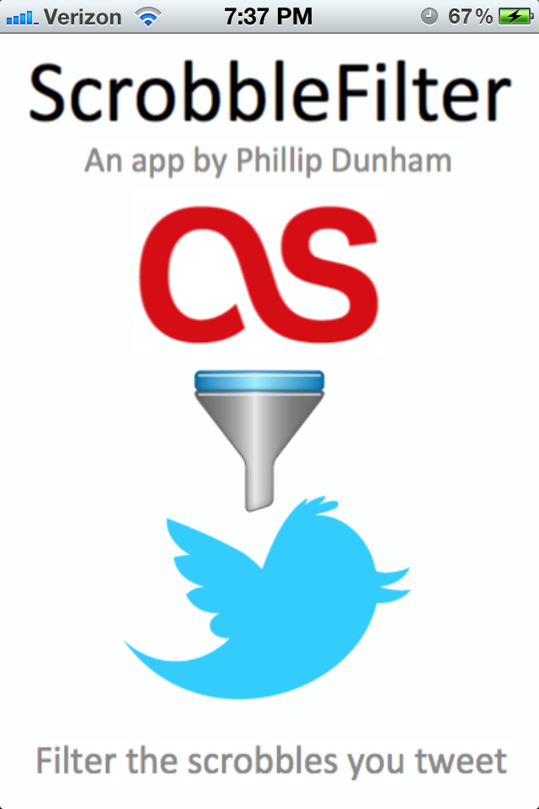
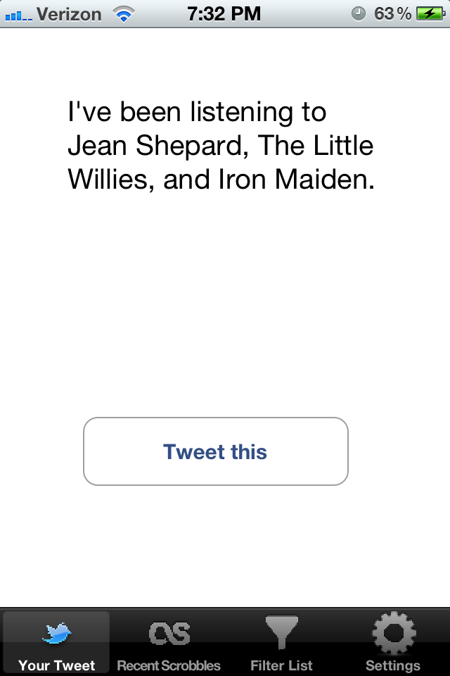
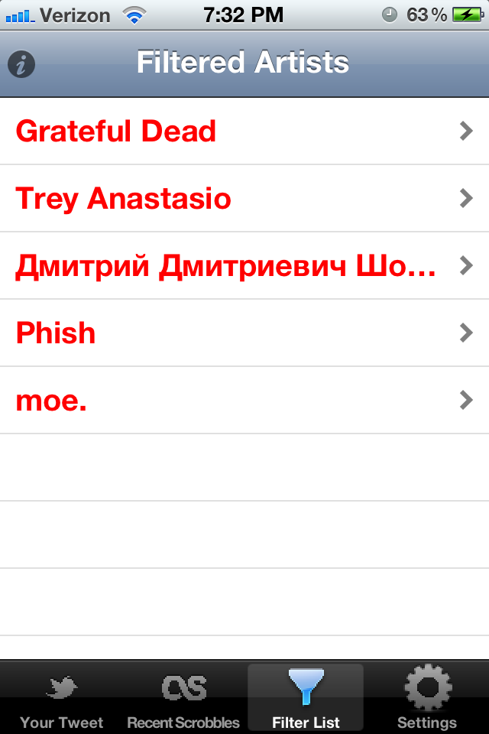
Screenshots

